Slide 1
VIRTUWORK A Global Hub for Task-Based Services
Presented By SREEPRIYA I P
B 53
Under The Guidance: Dr. Rakhi Venugopal
Scrum:Ms Joice T

Slide 2
OBJECTIVE
VirtuWork is a global freelancing hub connecting clients with freelancers for diverse task-based services, such as coding, design, and writing. The platform uses machine learning to recommend tasks based on user skills and preferences, ensuring intelligent matching. It features task progress tracking, a reward system based on client ratings, and secure payment gateways, fostering transparency and professionalism. Admin-mediated communication ensures safety, with a 10% admin fee sustaining operations. By leveraging data-driven insights, VirtuWork provides an intuitive, user-centric experience, promoting quality work and seamless collaboration.

Slide 3
SOCIAL RELEVANCE
Empowering Freelancers:VirtuWork provides a platform for freelancers to showcase their skills, access global clients, and secure jobs, thus promoting self-employment, financial independence and provide them oppurtunities.
Global Accessibility:By connecting clients and freelancers worldwide, VirtuWork bridges geographical gaps and creates opportunities for collaboration without physical boundaries.
Skill Development and Utilization:Freelancers can leverage the platform to refine their skills through task recommendations and earn rewards, encouraging continuous learning and professional growth.
Transparent and Secure Work Environment:The admin-moderated communication ensures a secure and professional environment, reducing risks of fraud or disputes between clients and freelancers.
Reward-Based Ecosystem:The reward system based on ratings and feedback motivates freelancers to deliver high-quality work while encouraging clients to provide constructive reviews.

Slide 4
DESCRIPTION
VirtuWork is a web-based platform that connects clients and freelancers for task-based services across domains like coding, designing, and writing.
It features a task recommendation system using machine learning, a reward system based on client ratings, and admin-mediated communication to ensure professionalism and security.
Clients can track task progress, while secure payment gateways allow freelancers to redeem earned rewards. The admin earns a 10% service fee for managing the platform, fostering a transparent and efficient remote work environment.
VirtuWork promotes skill development, inclusivity, and growth in the gig economy.

Slide 5
EXISTING SYSTEM
Direct Communication Challenges:Clients and freelancers often face unstructured and informal communication, leading to misunderstandings and disputes.
Generic Task Allocation:Current platforms lack advanced matching mechanisms, often assigning tasks that don't align with freelancers' skill sets and experience.
Limited Feedback Utilization:Existing systems do not effectively use client feedback to enhance task allocation or freelancer motivation.
Inconsistent Task Monitoring:Clients struggle to track task progress, making it difficult to ensure deadlines and quality standards are met.

Slide 6
PROPOSED SYSTEM
Centralized Admin Communication:Admin-mediated communication streamlines interactions, ensuring professionalism and resolving disputes efficiently.
Machine Learning-Based Task Matching:Uses ML algorithms to match freelancers with tasks based on skills, experience, and past performance, improving relevance and satisfaction.
Comprehensive Reward System:Introduces points for positive feedback and successful task completions, redeemable for platform discounts or other benefits.
Advanced Task Tracking:Real-time dashboards provide clients with clear visibility into task progress, milestones, and deadlines.

Slide 7
System Design (Preliminary Modules / Components Description:
User Module:
Description: This module handles the registration, authentication, and profile management for both clients and freelancers.
Key Features:
User sign-up and login (email/password or social login).
Profile creation and updates (skills, experience, portfolio for freelancers).
Account deletion.

Slide 8
2. Task Management Module:
Task Management Module
Description: Facilitates the creation, assignment, progress tracking, and completion of tasks.
Key Features:
Clients can post tasks with specific requirements and budgets.
Admin upload tasks to suitable freelancers.
Task status tracking (e.g., "In Progress," "Completed").
Notifications for task updates and deadlines.

Slide 9
3. Admin Panel Module
Description: A centralized dashboard for the admin to manage users, tasks, and communication.
Key Features:
Approve or reject user registrations.
Oversee task creation and assignment.
Facilitate communication between clients and freelancers.
Monitor platform activities .

Slide 10
4. Task Recommendation Module
Description: Utilizes machine learning to suggest tasks to freelancers based on their profiles and past activities.
Key Features:
Analyze freelancer skills, experience, and preferences.
Suggest tasks matching freelancer capabilities.
Update recommendations based on user feedback and task history.

Slide 11
4. Task Recommendation Module
ML Algorithm Used:
Collaborative Filtering:Collaborative filtering is widely used in recommendation systems. It analyzes user interactions, such as completed tasks or skills, and compares them with similar users to recommend tasks.
Content-Based Filtering:This approach focuses on the user’s skills, preferences, and task descriptions to recommend relevant tasks.
Hybrid Recommendation System:Combines collaborative filtering and content-based filtering to address the limitations of each and improve task recommendations.

Slide 12
4. Task Recommendation Module
Details of ML Workflow:
Dataset Preparation:Features: User skills, experience, past tasks, task descriptions, and categories.
Data Preprocessing:Encode categorical variables (e.g., skill sets, task categories
Model Training:Train content-based filtering models using algorithms like K-Nearest Neighbors (KNN) or Logistic Regression.
Task Recommendation:Input: User profile (skills, experience) and past tasks.Output: A ranked list of tasks tailored to the user.

Slide 13
5.Reward System Module
Description: Implements a points-based reward system for freelancers based on client ratings and feedback.
Key Features:
Assign reward points for successful task completion.
Allow freelancers to redeem points for payment discounts.
Display rewards earned and redeemed in the freelancer dashboard.

Slide 14
6. Payment Module
Description: Handles secure transactions, admin commission, and reward point integration.
Key Features:
Support for multiple payment gateways (e.g. cards, gpay).
Apply reward points for partial or full payment.
Automatically deduct 10% of the payment as an admin fee.

Slide 15
7. Feedback and Rating Module
Description: Collects and displays client feedback and ratings for freelancers after task completion.
Key Features:
Clients rate freelancers on task performance.
Feedback is visible on freelancer profiles.

Slide 16
8. Progress Tracking Module
Description: Enables clients to monitor the progress of assigned tasks through a dashboard.
Key Features:
Real-time updates on task milestones.
Notifications for delays or completion.
Visual indicators (e.g., progress bars) for task tracking.

Slide 17
TOOLS AND TECHNOLOGIES
Frontend:React.js for developing a responsive user interface.
Backend:Node.js with Express.js for server-side development and handling business logic.
Database:MongoDB for storing data related to users, tasks, ratings, payments, and feedback.
Machine Learning:Scikit-learn for task recommendation algorithms based on user profiles, skill sets, and preferences.
Version Control:Git and GitHub for managing code and collaboration.

Slide 18
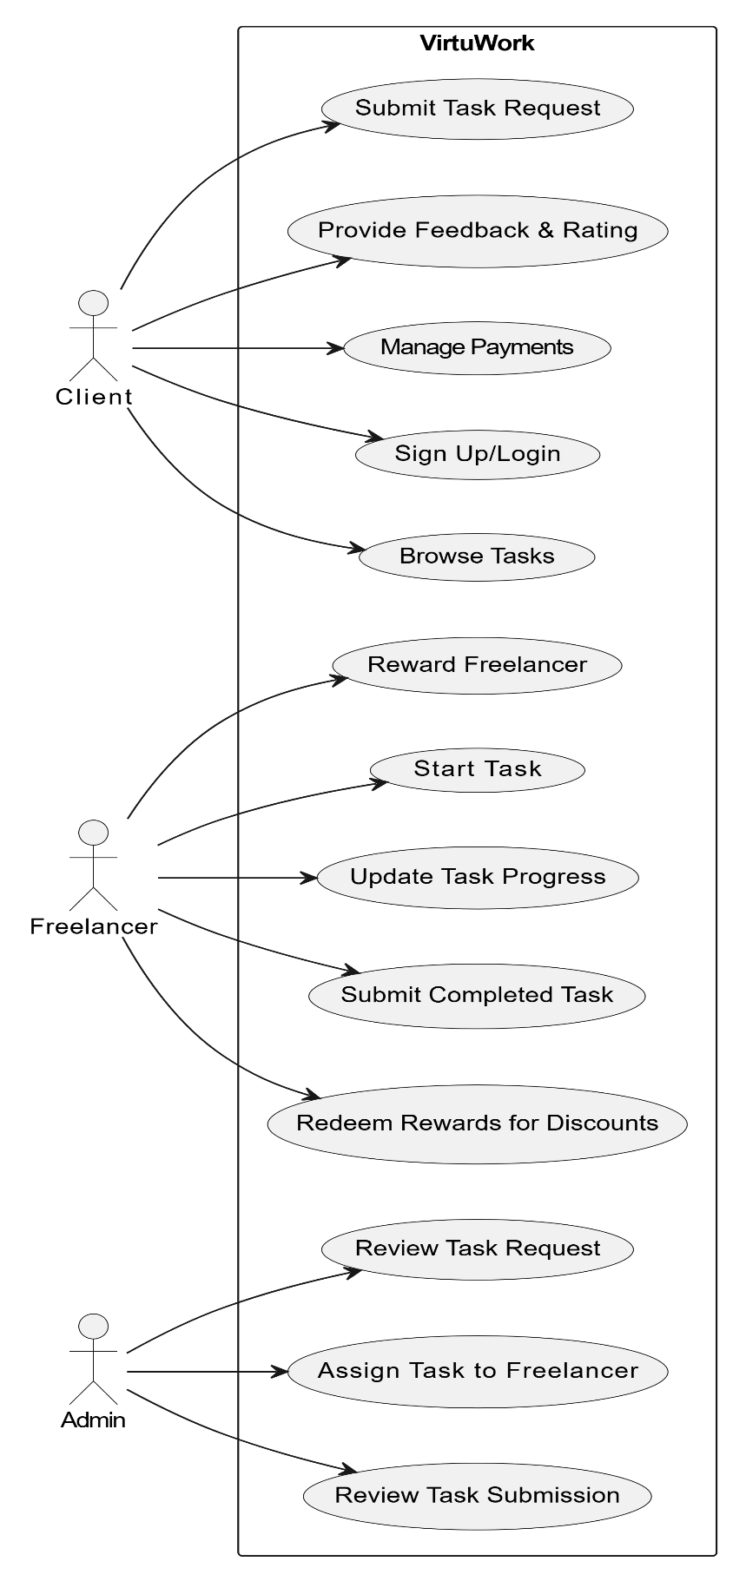
USE CASE DIAGRAM

Slide 19
FUTURE SCOPE
Enhanced Task Recommendation:Leveraging advanced AI and machine learning algorithms to provide more accurate task suggestions tailored to user profiles and evolving skills.
Mobile Application Development:Launching a dedicated mobile app to increase accessibility and convenience for users, enabling seamless task management on the go.
Advanced Reward System:Expanding the reward system with gamification features like badges, levels, and redeemable benefits to boost user engagement and loyalty.
Freelancer Skill Development:Offering training programs and certifications to freelancers to enhance their skills and improve their marketability.

Slide 20
CONCLUSION
VirtuWork bridges the gap between clients and freelancers by offering a seamless platform for task-based collaborations. With its unique features such as AI-powered task recommendations, a secure admin-mediated communication system, and a dynamic reward mechanism, the project promotes efficiency, transparency, and accountability. By integrating advanced technologies and focusing on user-centric functionalities, VirtuWork not only addresses the challenges in the freelancing ecosystem but also fosters a thriving community of skilled professionals and satisfied clients. This innovative solution has the potential to revolutionize remote task management, ensuring a sustainable and scalable future for the gig economy.

